Slide 1
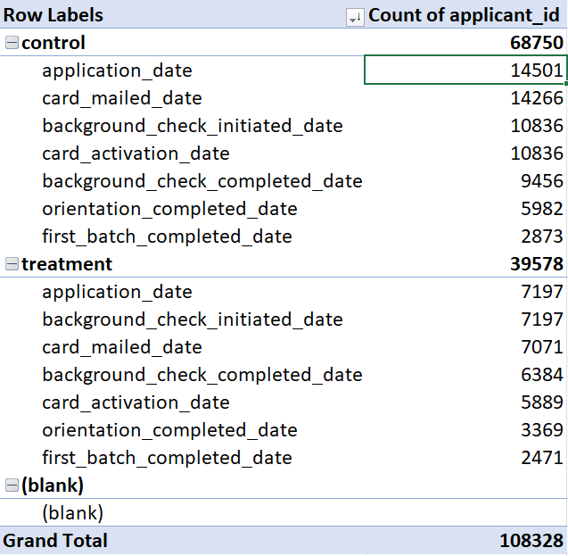
20% conversion rate for control 34% conversion rate for treatment

Slide 2
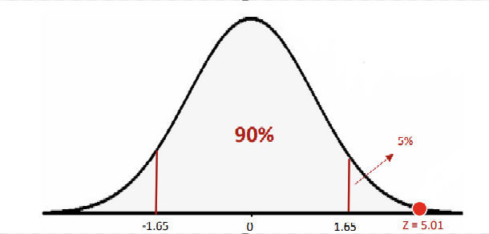
The data result is just from the sample, we need test is that change increasing the conversion rate.
Based on the data, we got result on the red point. The meaning for this graph is that we assume all the possibility is list here and there is 90% that our change will make a positive change.
As a conclusion, we need to make this change.

Slide 3
Cost- Effective Check
 | Control | Treatment
Background Checking Cost | 325080 | 215910
Number of New Shopper | 2873 | 2471
Cost/New Shopper | $113.15 | $87.38
According to the historical data, we can see the cost before and after the change. From the graph above, it shows the background check cost per shopper.
Each new shopper will cost $87.38, which is cheaper compared to $113.15.

Slide 4
Other Observation
- There is another possible cause that could affect the conversion rate, which is the time to complete the pre-requisites.
- Unavoidable waiting time will decrease the momentum for the new shopper. In this case is the waiting time to receive the prepaid card.
- The other observation can be made as changing the prepaid card mailing process to prepaid card pickup point. Company can set up pickup point or cooperate with some local store like 7-Eleven. This can help new shoppers to pickup the card at anytime, which means that they do not have to wait for the card.
- In this observation, we need to check the conversion rate to see did this change increase the rate. Also, we need to check the cost-effectiveness again to make sure the expense is worth it.

